Slide 1
Class 3.3: Virtual bidding strategy in wholesale electricity markets
S. Bose
Electrical and Computer Engineering
University of Illinois at Urbana Champaign
ECE 398 BD: Making sense of big data.
Fall 2018.

Slide 2
Price at a location reflects the locational need for power at that location
DA market results
11 am on previous day
5mins
3pm
4pm
1 hour
Line capacity = 1
Average real time price
= average of 12 prices obtained from each 5 min market.

Slide 3
Lab 3: Given historical price spreads, design an algorithm to bid into NYISO’s virtual bidding market.
Which (zone, hour) combination should we bid on? How much?

Slide 4
Types of virtual trades
Two types of virtual bids:
(INC bids) Generate a certain amount in the DA market at a certain price.
(DEC bids) Demand a certain amount in the DA market at a certain price.
They automatically assume the opposite position in the real-time market.
INC bids: they act as demanders in the RT market.
DEC bids: they act as generators in the RT market.
We will only consider DEC bids.

Slide 5
DEC bid format at each hour
A trader puts in a bid that is composed of
and .
The bid expresses the trader’s intent to buy “upto” MW of power at or below a price of $/MW at that zone.
She competes with other entities in the market who put in bids to buy power at different prices.
Her bid can only clear when her bid price is higher than the DA market price at that zone.

Slide 6
Outcome of bid at a given hour
The bid clears if .
The whole quantity is cleared.
Trader pays .
Trader is paid .
Trader profits .
…for demand in DA market
…for automatically enrolled to generate in the RT market

Slide 7
Trading pipeline
You decide:
Your bid clears if:
If cleared, you make:
If not cleared, you make 0.
What limits how much you can spend?
Day-ahead payment:
Risk associated with negative payments

Slide 8
Trading strategy
Train on 2015 data and use it to trade on 2016 data.
Buy 1MW worth of DEC bid at a time, and decide which (zone, hour) combination to buy.
Whenever you buy a DEC bid, think that you are spending amount of money.
Assume a daily budget, say $250,000.
Each time you buy a DEC bid for a zone and hour, you subtract from your budget.
How do we pick ?

Slide 9
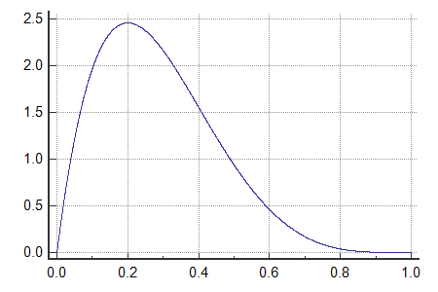
Choosing
Recall that you need to get cleared!
We choose the bid price to be a quantile of historical prices, i.e., over 2015.
Effect of choosing a larger α?
α quantile
Probability distribution of historical DA prices (smoothed)
Probability of this tail = 1-α

Slide 10
How do we pick the zones and hours?
For each zone-hour pair, predict whether a DEC bid will be in the money or out of money, i.e., predict the sign of .
What would provide useful information about this price spread (price difference)?
Prices in DA and RT markets across zones and hours in the past few days.
Load conditions in the past few days across zones and hours.
Train a classifier!

Slide 11
What kind of classifiers?
Let’s be practitioners for a bit.
MLPClassifier, SVM, etc. You can use any classifier you like, or a combination of multiple ones.
Detour: Multiclass v/s multilabel classification.
Training accuracy may be high, but testing accuracy can be quite poor. Real market price differences can be difficult to predict because systematic biases in price movements should be rare for a relatively competitive market.

Slide 12
Using the outputs of the classifier
Among these 264 zone-hour pairs, the classifier will predict the signs of some price differences to be positive. Call them
Compute the historical average return from each zone, hour.
Choose a DEC bid among probabilistically, where the probability of choosing is given by
Why probabilistic choice?

Slide 13
Any other trading strategies?
Be creative!

Slide 14
A peek into the next lab
Pecan Street dataset: https://www.pecanstreet.org/category/dataport/
Customer residential power usage data from various cities such as Austin, Boulder, San Diego, etc.
Why should we analyze customer data?
Structure of your electricity bill and predicting solar savings.

